Slide 1

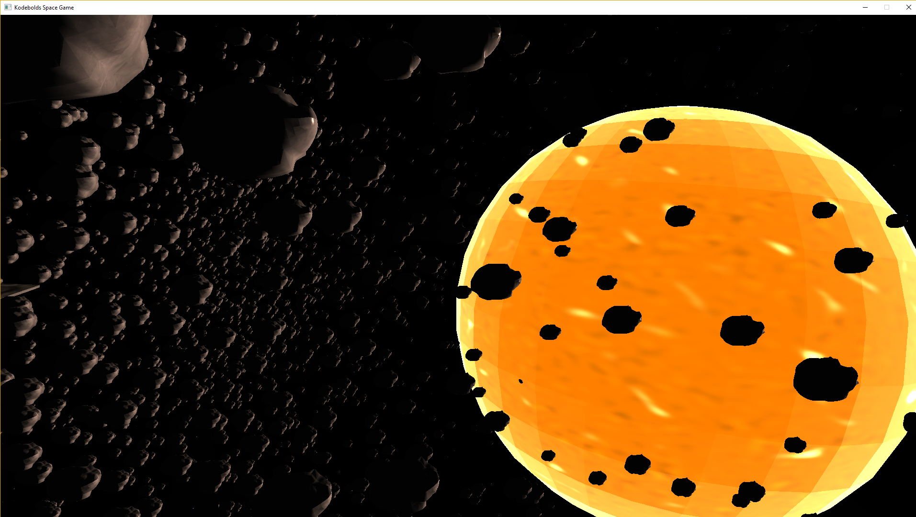
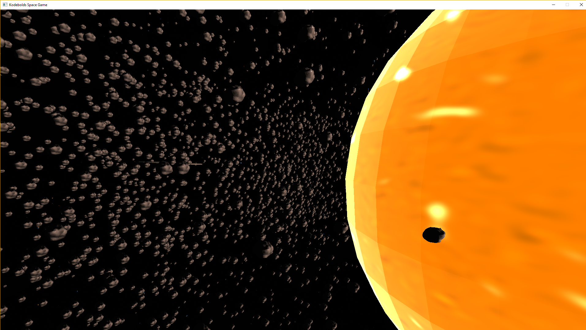
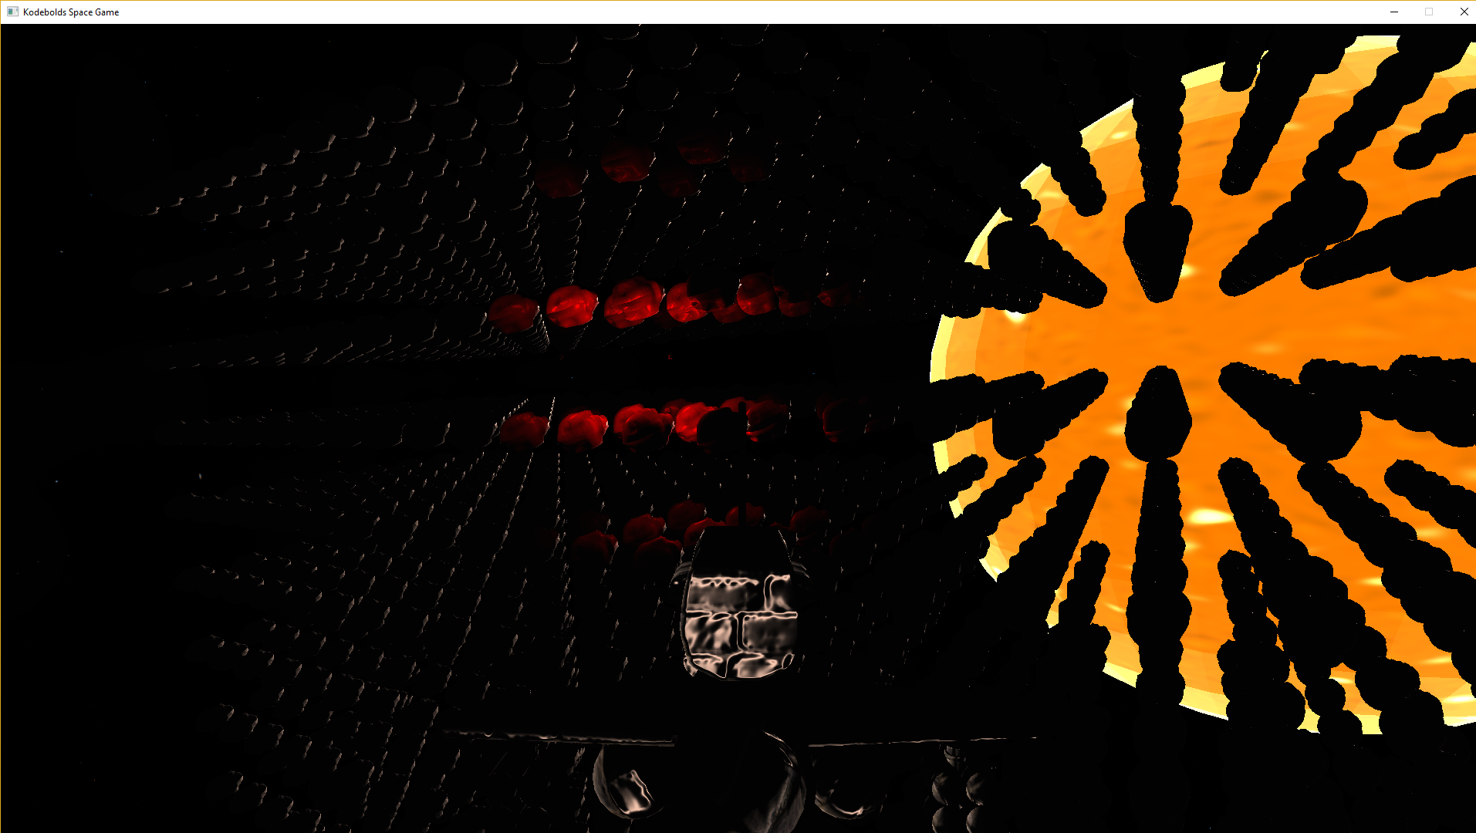
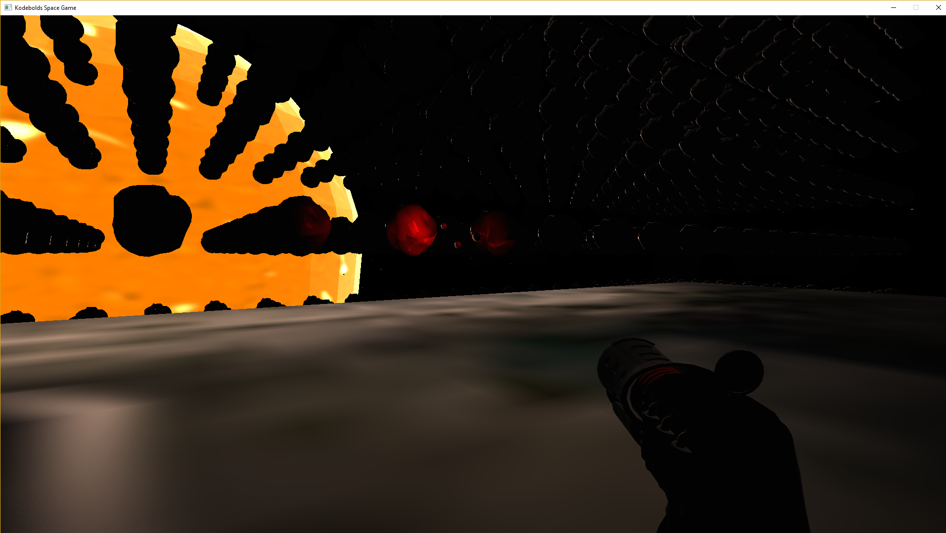
Entity Component System Game Engine
Entities - ID & Mask
Components - Data
Systems - Game Logic
Managers - Engine Functionality
Custom Components and Systems
C++ and DirectX11
Networking
Multithreading
Oct Tree Collision Detection
Custom Maths Library
Audio
3D Rendering
- Texturing
- Normal Mapping
- Shadow Mapping
- Particle Systems
- Directional and Point lights

Slide 2
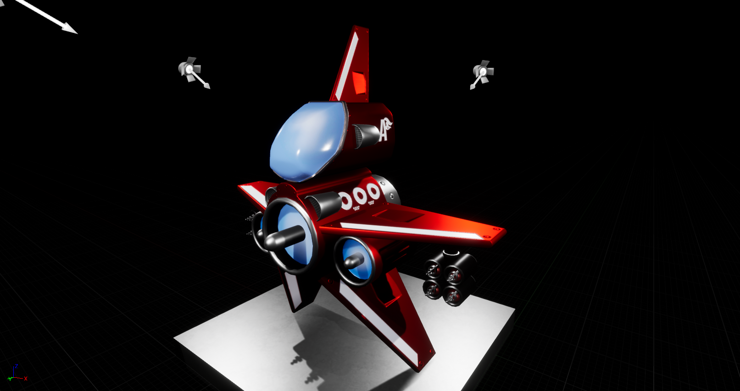
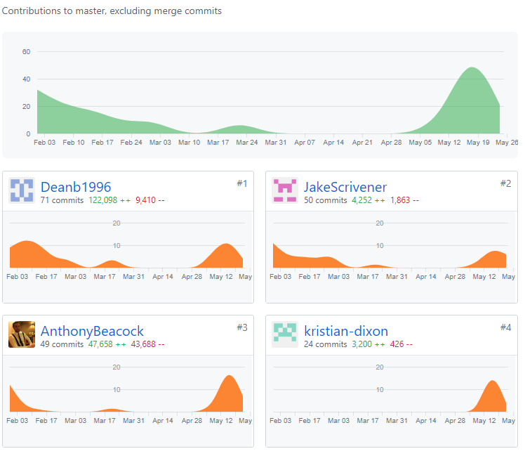
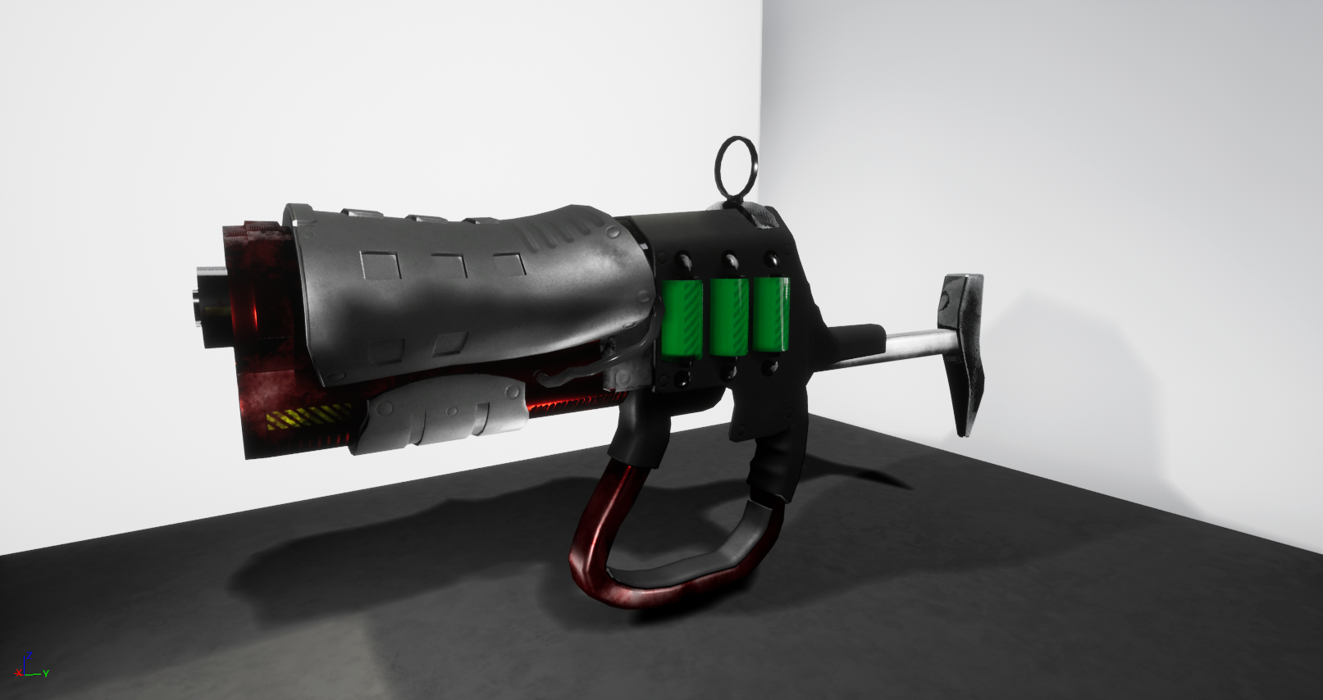
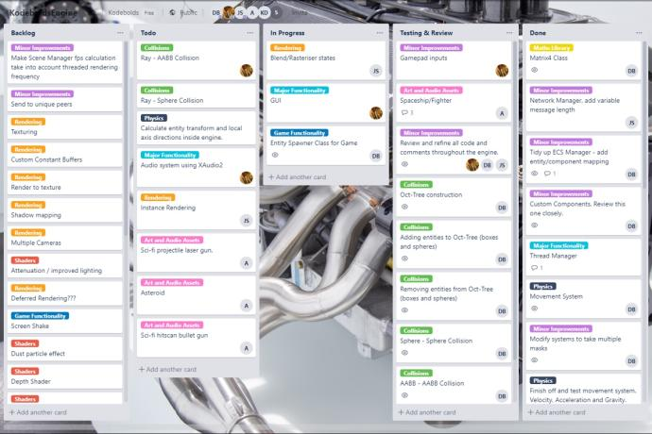
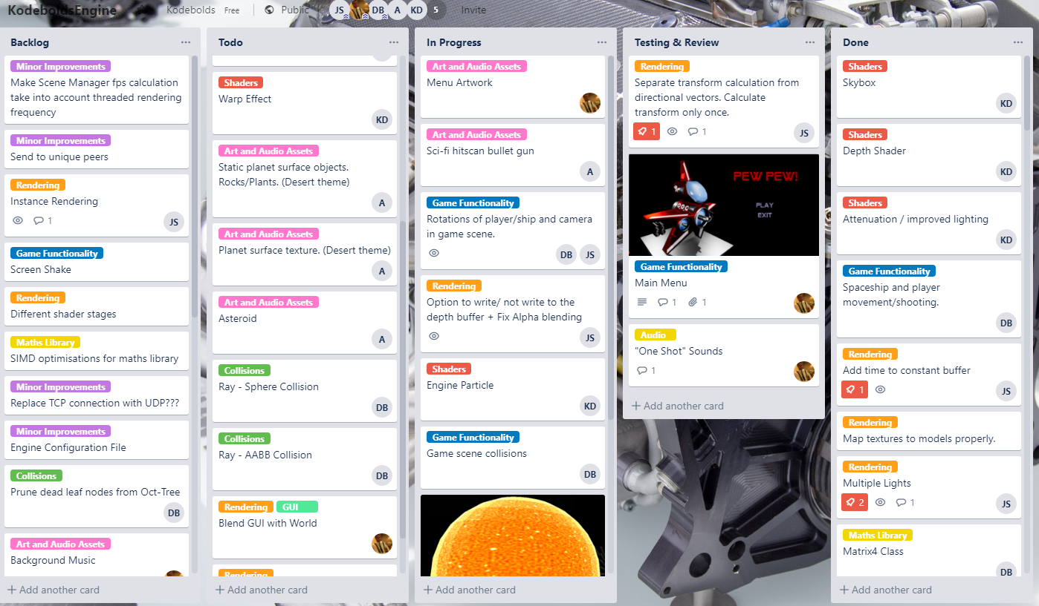
Kodebolds Team Project
Multi-Disciplinary Group
Project Management
- Trello
- Github
- Code Reviews
Artistic Quality
- 3D Assets
- Shader Effects
Technical Quality
- C++ and DirectX11
- Multiple Systems – Multiple Challenges
- Data Oriented Architecture

